Slide 2
Preparing for ALMA
http://science.nrao.edu/alma
National Radio Astronomy Observatory
North America ALMA Science Center
Charlottesville, Virginia U.S.

Slide 3
The North American ALMA Science Center
Carol J. Lonsdale
North American ALMA Science Center

Slide 4
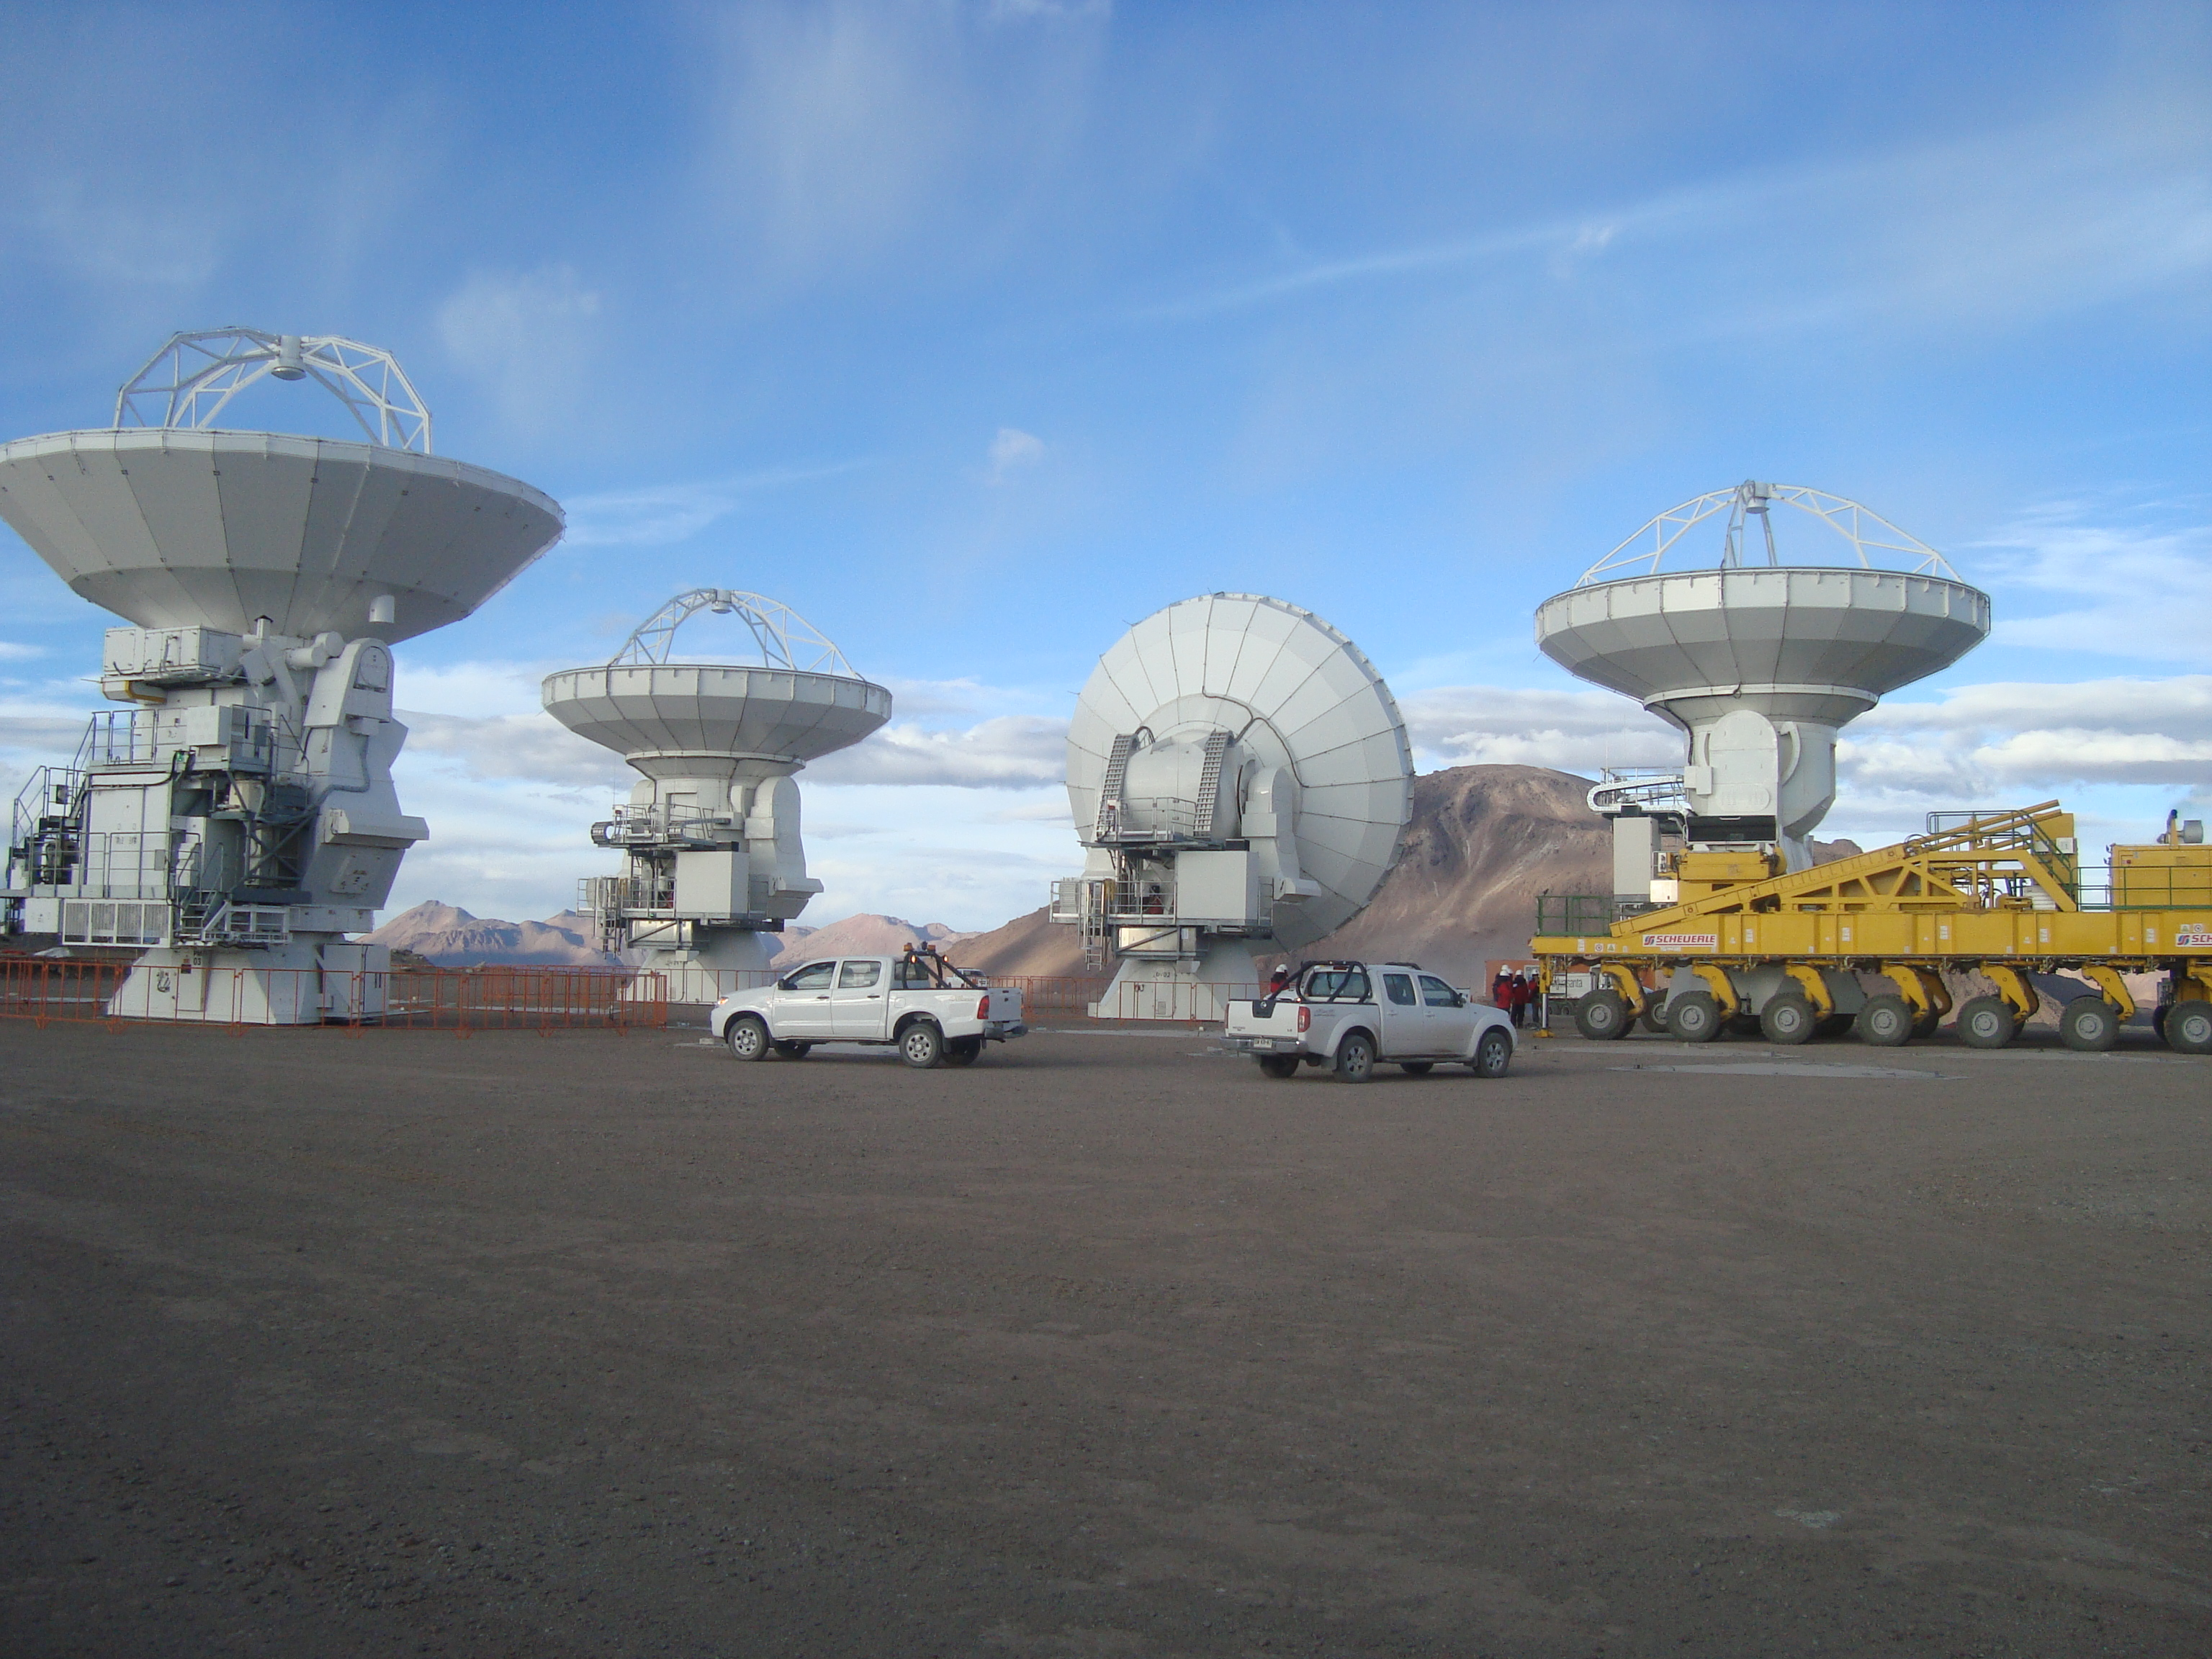
It’s Time to Plan ALMA Science !!!!
Four Antennas at the ALMA Site; May 2010
First Call for Proposals: December 2010
First Science Observations: July 2011

Slide 5
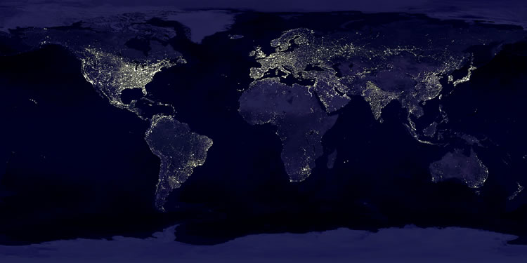

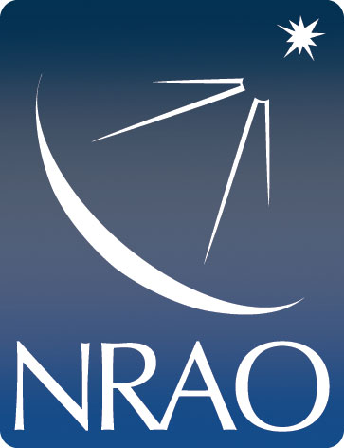



The North American ALMA Science Center
NAASC, NRAO, is the observer’s interface to all things ALMA in North Am.
The NA ALMA Regional Center (ARC) interfaces with Chile, Europe & East Asia

Slide 6
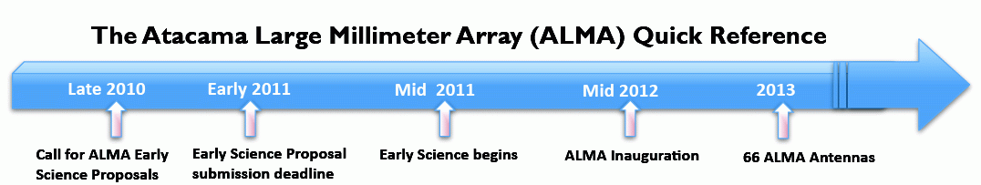
Milestones
November 27, 2009: Phase closure achieved with 3 antennas
January 22, 2010: Start of Commissioning & Science Verification
October 2010: Operations Readiness Review
December 2010: First Call for Proposals
July 2011: Start of Early Science operations; 16+ antennas
January 2012: Science verification for 32 antenna
September 2012: Inauguration: 50+ antennas in place
April 2013: 66 antennas in service

Slide 7

ALMA must be accessible to all
NAASC will provide:
  Calibrated reference images
    All data will be image cubes
  On-line learning resources
  Workshops, tutorials & schools
  One-on-one support for visitors
  Student and Postdoc programs
  Financial Support:
    Data reduction visits
    Students working on ALMA data
    Page charge support

Slide 8
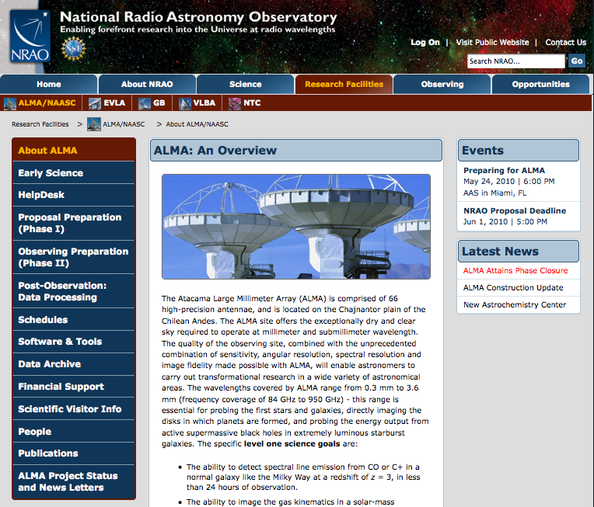
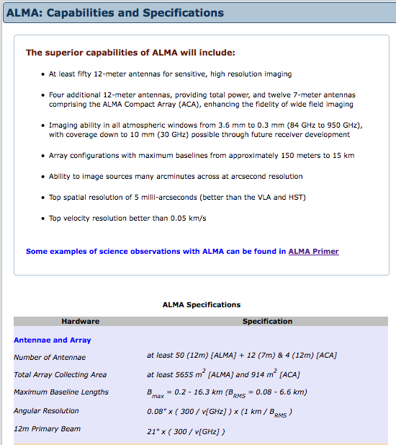
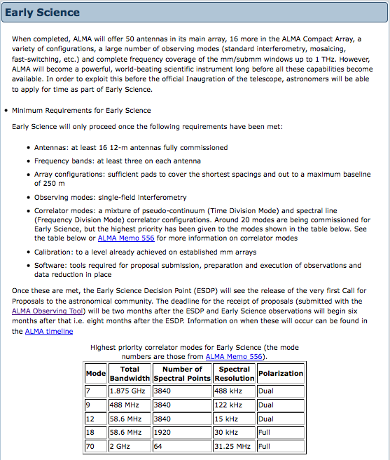

Slide 9
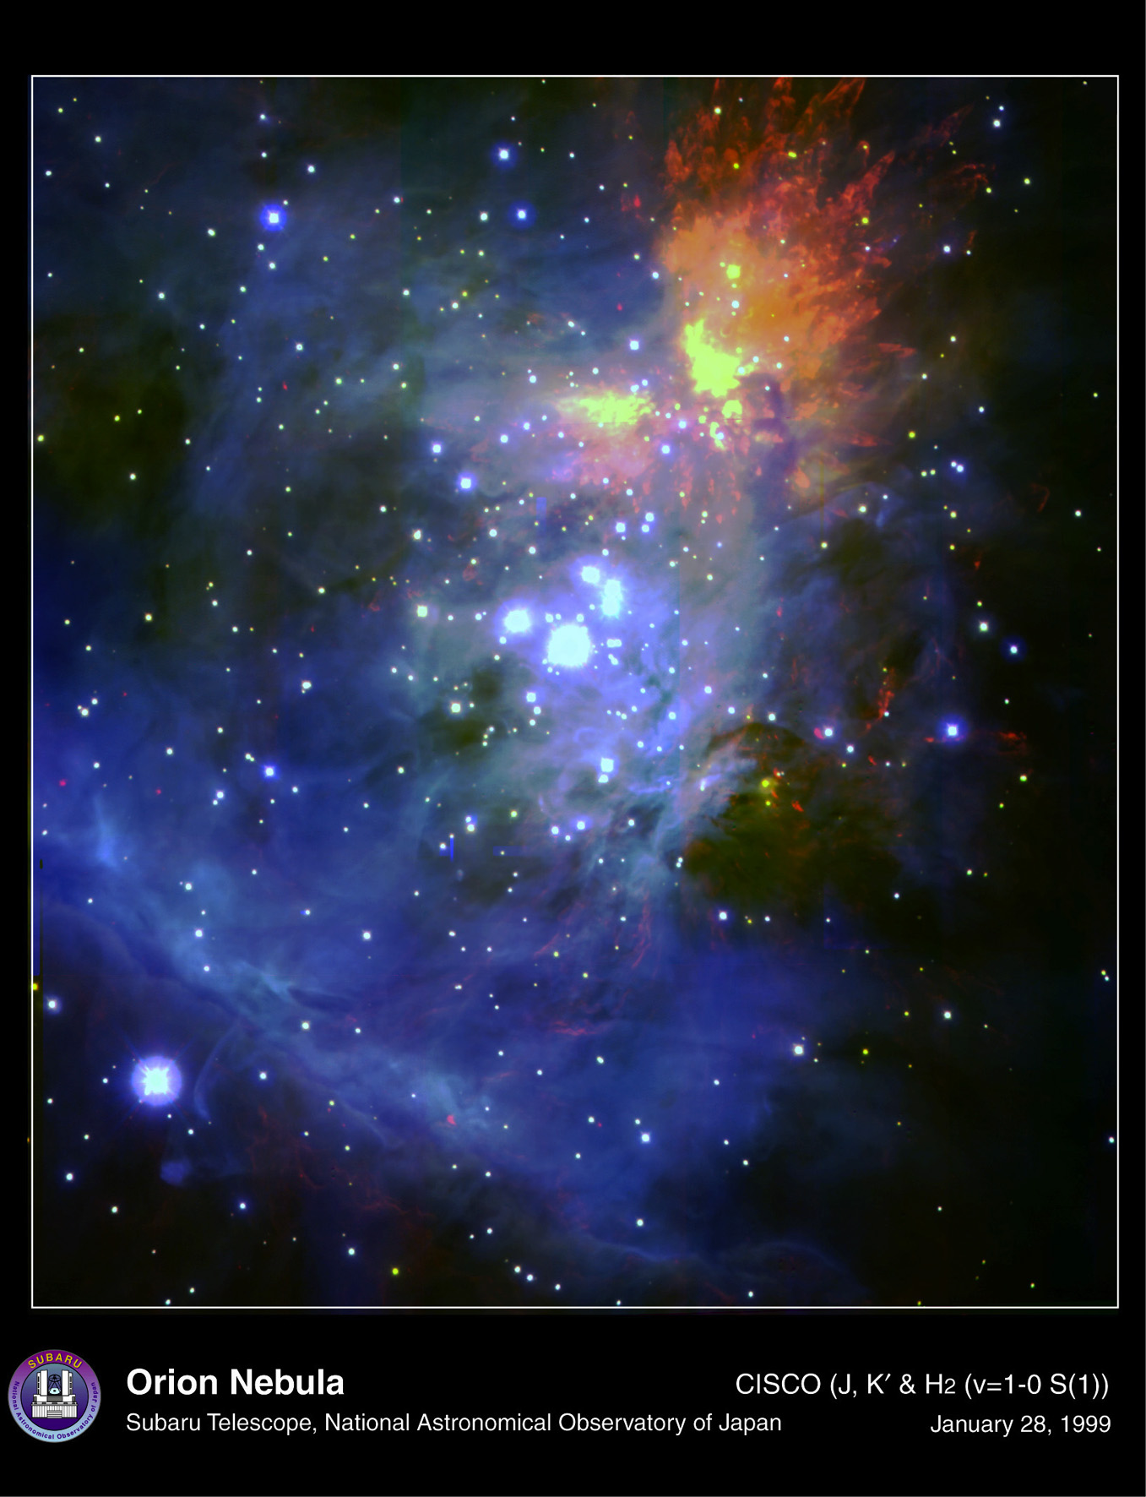
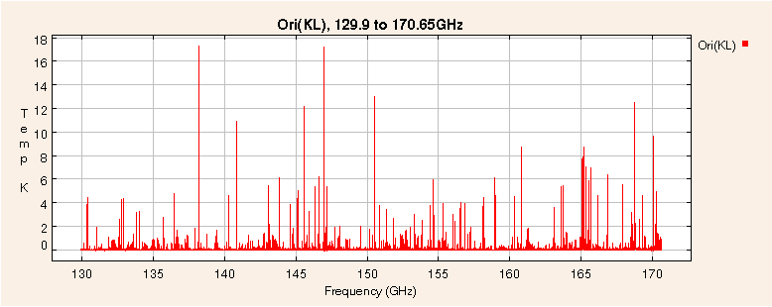
The Complex mm Spectrum
Most of the observed transitions of the 142 known interstellar molecules lie in the mm/submm spectral region.
Here 1000s lines are seen in a small portion of the spectrum at 2mm.
Slide courtesy of Al Wootten
9

Slide 10
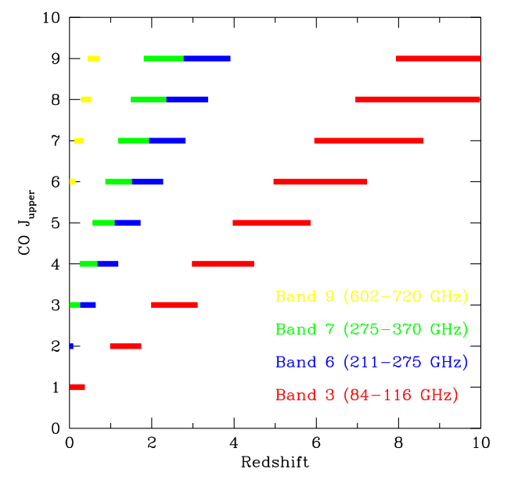
CO transitions at high z

Slide 11
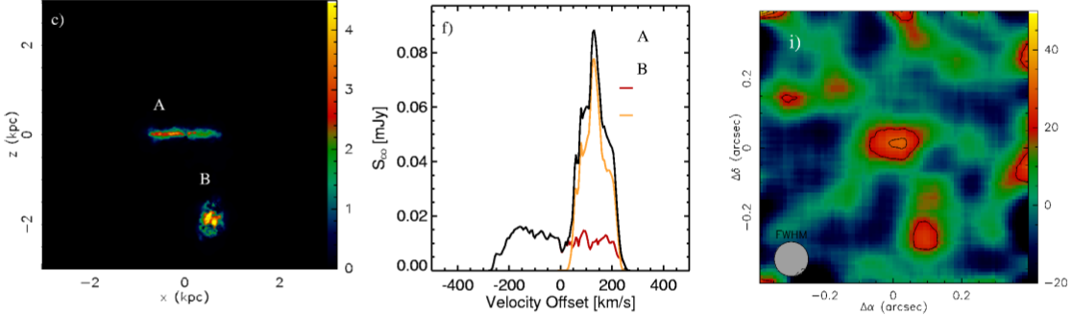
CO Line Emission from Lyman Break Galaxies
Greve & Sommer-Larson 2008
z=3.26
Simulation CO(4-3) map, 0.1” resolution

Slide 12
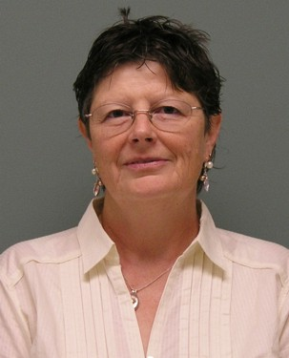
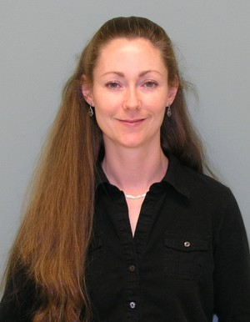
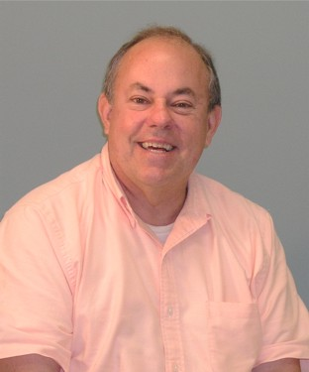
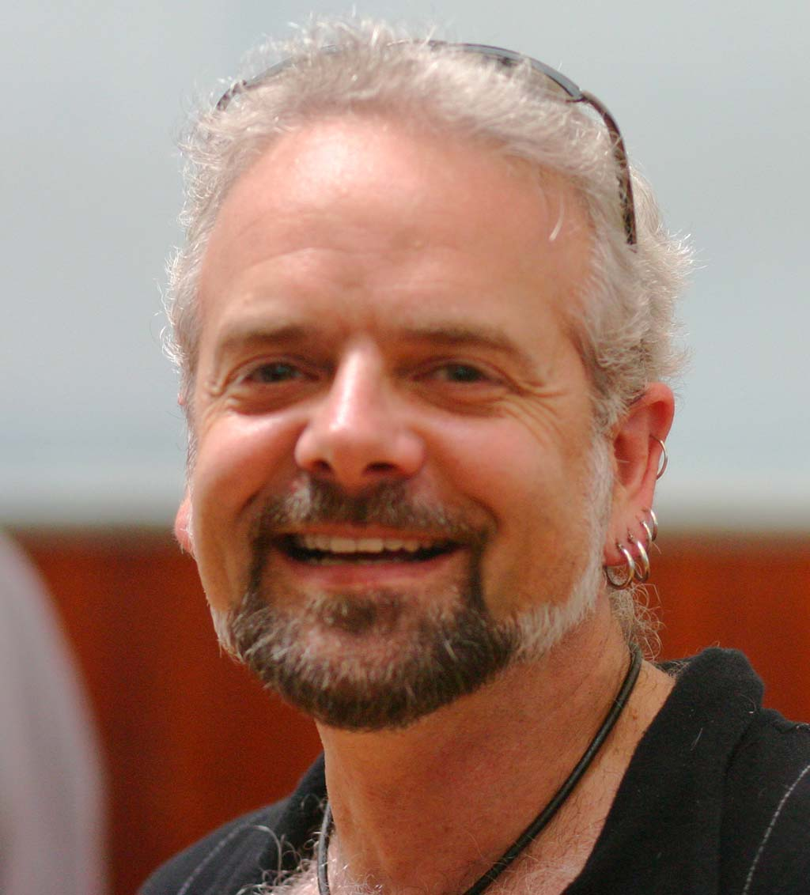
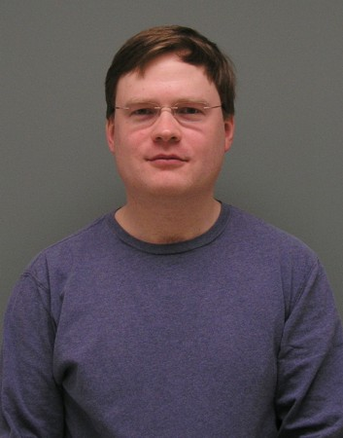
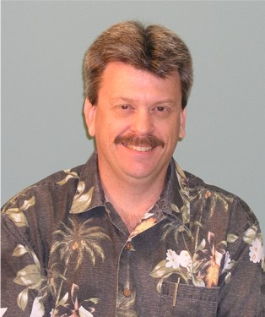
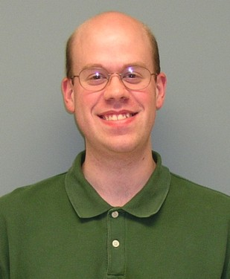
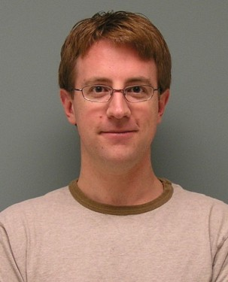
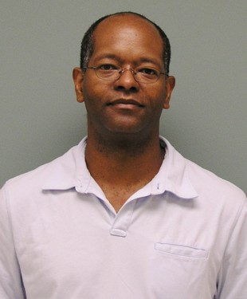
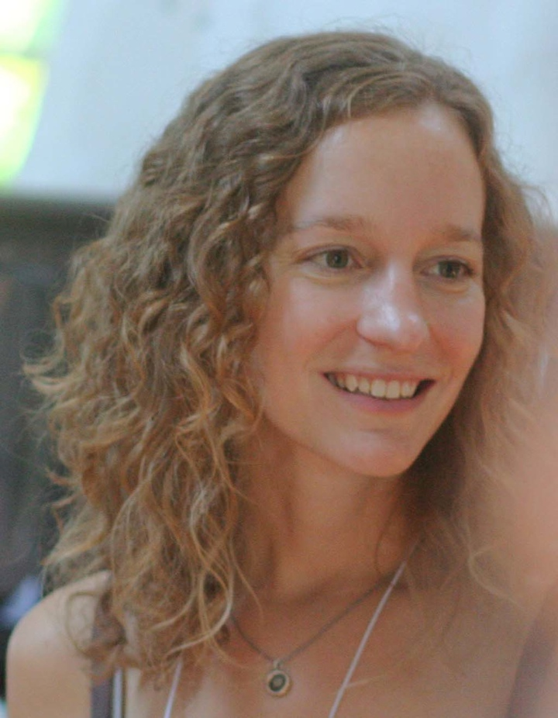
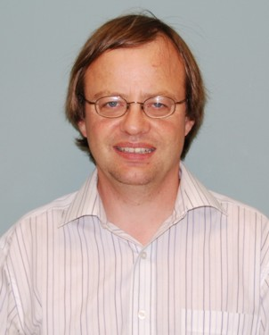
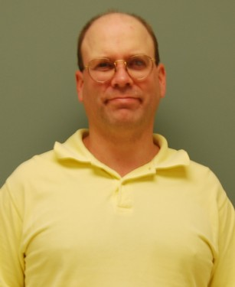
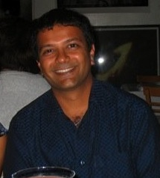
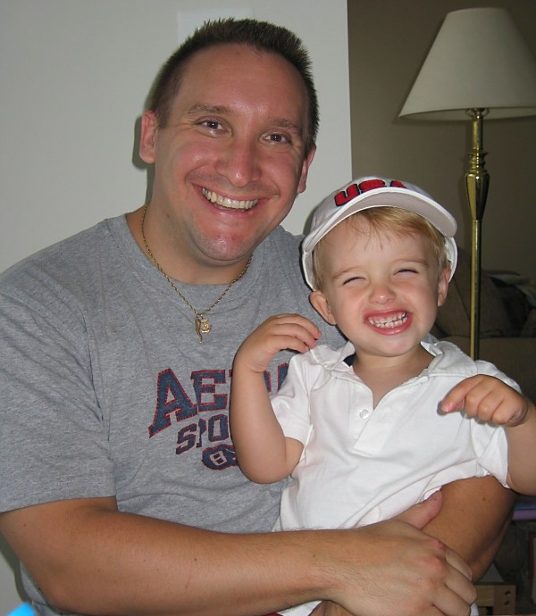
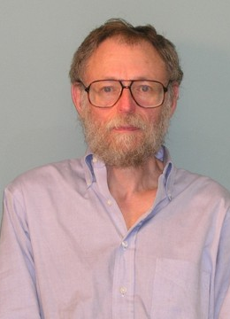
Meet The NAASC
Carol
Lonsdale
Crystal
Brogan
Al
Wootten
John
Hibbard
Todd
Hunter
Jeff
Mangum
Brian
Kent
Remy
Indebetouw
Aaron
Evans
Rachel
Friesen
Mark
Lacy
David
Mehringer
Kartik
Sheth
Tony
Remijan
Harvey
Liszt

Slide 13
PREPARING FOR ALMA
http://science.nrao.edu/alma
National Radio Astronomy Observatory
North America ALMA Science Center
Charlottesville, Virginia U.S.

